Slide 1
SPARK ON HIPERGATOR
Giljae Lee
giljael@ufl.edu
March 15th, 2018

Slide 2
agenda
Introduction
Spark on HiPerGator
Hands-on Exercises

Slide 3
Goals
Cover
Create Spark cluster in HiPerGator
Run Spark jobs in the Spark cluster
Does not cover
How to program Spark jobs
How to use Spark libraries
Notes:
In this session, we will experience Spark in HiperGator.

Slide 4
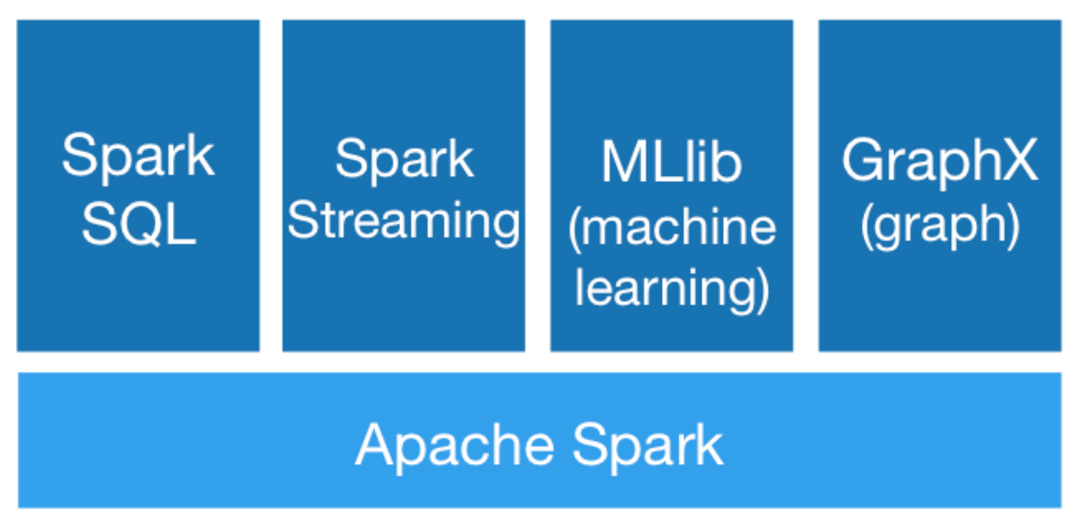
Spark ecosystem (Recap)
Notes:
One Good thing is that spark provide built-in easy-to-use libraries.

Slide 5
SPARk Ecosystem (Recap)
SparkSQL
Allows SQL-like commands on distributed data sets
Spark Streaming
Spark MLlib
Provide machine learning primitives
Spark GraphX
Provide API for graphs and graph-parallel computation
Support Python, Scala, Java, and R
Notes:
In this workshop, we’ll use python.

Slide 6
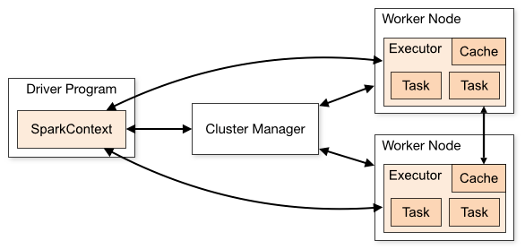
Spark Components
Spark cluster
Cluster manager (master): resource manager (standalone manager)
Worker node: any node running application.
Application: user program built on Spark. Driver program + executors
Driver program: process running the main() function of the application
Executor: process launched for an application on a worker node. it runs tasks.
Task: a unit of work that will be sent to one executor
Notes:
Spark cluster is a cluster runs Spark applications. It is manages by Spark manager and Spark workers

Slide 7
Spark Module in HiperGator
$> ml spider spark ---------------------------------------------------------------------------------------------------- spark: ---------------------------------------------------------------------------------------------------- Description: general-purpose cluster computing system Versions: spark/2.1.0 spark/2.2.0 ---------------------------------------------------------------------------------------------------- <<omitted>>
Notes:
Hipergator supports two versions of Sparks. In this workshop, we will use spark 2.2.0. The most recent version of Spark is 2.3.0 currently.

Slide 8
“No” Spark Cluster in hipergator
SLURM (resource allocation, job scheduler, workload management) on HiPerGator
Submit a SLURM job for Spark cluster
Client
Master
Worker
Worker
Worker
Worker
Notes:
If you want to use your own resources for Spark cluster, just run the Spark master and Spark workers. But setting Spark configuration parameters are necessary.
It doesn’t matter where your worker nodes run. You just need to know where the master node is running.
We don’t have to install spark module in HiPerGator but create a spark cluster with the spark module.

Slide 9
Set up your own spark cluster
Set SLURM parameters for Spark Cluster
How many nodes?
How many CPUs per node?
How long ?
...
#SBATCH --job-name=spark_cluster #SBATCH --nodes=1 #SBATCH --cpus-per-task=64 #SBATCH --exclusive # not sharing with other running jobs #SBATCH --time=03:00:00 #SBATCH --output=spark_cluster.log #SBATCH --error=spark_cluster.err …

Slide 10
Set up your own Spark cluster
Set Spark parameters for Spark Cluster
What is the working directory?
What is the port for communication between components?
What is the directory for logfiles?
…
export SPARK_LOCAL_DIRS=$HOME/spark/tmp export SPARK_WORKER_DIR=$SPARK_LOCAL_DIRS export SPARK_WORKER_CORES=$SLURM_CPUS_PER_TASK export SPARK_MASTER_PORT=7077 export SPARK_MASTER_WEBUI_PORT=8080 export SPARK_NO_DAEMONIZE=true export SPARK_LOG_DIR=$SPARK_LOCAL_DIRS …

Slide 11
Set up your own Spark cluster
Set Spark Master and Workers
Spark Master is a daemon for cluster management
The master waits for workers to connect with
Spark worker is a daemon for a node management
The workers need to register to the master
# start master $SPARK_HOME/sbin/start-master.sh & # start worker $SPARK_HOME/sbin/start-slave.sh \ spark://$SPARK_MASTER_NODE:$SPARK_MASTER_PORT

Slide 12
“Almost” Spark cluster in hipergator
Submit the SLURM job script to SLURM
“sbatch” is used to submit the script
The script, spark-local-cluster.sh is provided in
/ufrc/spark_workshop/shared
“squeue” is used to check your job status
$> sbatch spark-local-cluster.sh Submitted batch job 18070836 $> squeue –u giljael JOBID PARTITION NAME USER ST TIME NODES NODELIST(REASON) 18070836 hpg2-comp spark_cl giljael R 0:04 1 c29a-s42

Slide 13
“NoW” Spark cluster in hipergator
$> grep "Starting Spark master" spark_cluster.err 18/03/13 14:53:23 INFO Master: Starting Spark master at spark://c29a-s42.ufhpc:7077 $> grep "Starting Spark worker" spark_cluster.err 18/03/13 14:53:24 INFO Worker: Starting Spark worker 172.16.194.59:42418 with 16 cores, 124.3 GB RAM
Master&
Worker
Client

Slide 14
DIY1: 1-node spark cluster
Step 1: Login to HiPerGator & get on dev node
Step 2: Copy the scripts in /ufrc/spark_workshop/shared/ to your directory and edit it
Step 3: Submit the script to HiPerGator using sbatch
Step 4: Check the status of your job using squeue
$> ssh <YOUR_ID>@hpg2.rc.ufl.edu $> module load ufrc $> srundev --time=180 --ntasks=1 --cpus-per-task=4 --mem=6gb
$> cp /ufrc/spark_workshop/shared/* ~/ $> cd ~/; ls
$> sbatch spark-local-cluster.sh
$> squeue –u <your ID>

Slide 15
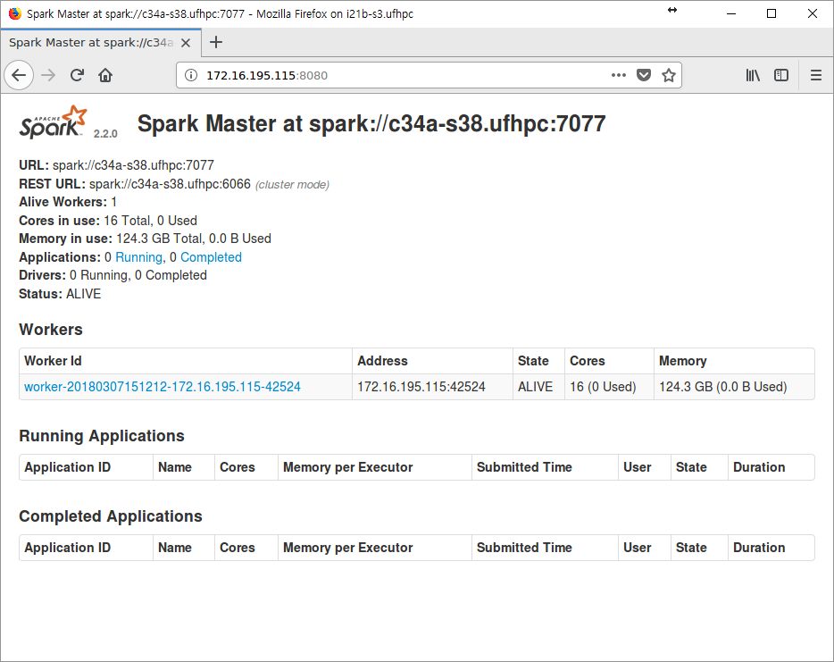
Spark Monitoring
Spark provides a web-interface to monitor its resource usage and job histories.
However, …

Slide 16
Spark Monitoring
“gui” module in HiPerGator to enable user to open a GUI session accessible from a local (your) machine
Xpra (GUI Persistent Remote Applications): a tool which runs GUI clients, typically on a local (your) machine, and directs its display to the remote (HiPerGator) machine without losing any state (https://en.wikipedia.org/wiki/Xpra)

Slide 17
DIY2: Spark Web Monitoring through Xpra
Step 1: Launch a GUI client using Xpra in your local machine
Step 2: Open a GUI session in HiPerGator
Step 3: Connect your GUI client to HiPerGator through the GUI session
Step 4: Enjoy Spark web-based monitoring
Notes:
This is wat we will do for this exercise

Slide 18
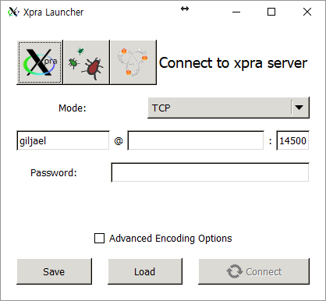
DIY2: Spark Web Monitoring through Xpra
Download and install Xpra on your local machine
https://help.rc.ufl.edu/doc/GUI_Programs
Run Xpra

Slide 19
DIY2: Spark Web Monitoring through Xpra
Download and install MobaXterm with default setup
https://mobaxterm.mobatek.net/
Create a wrapper shell script “xpra” in MobaXterm directory
Windows
Documents/MobaXterm/slash/bin/
MacOS X
/Applications/Xpra.app/Contents/MacOS
Linux
Follow the instructions in https://help.rc.ufl.edu/doc/Xpra_Linux_Installation

Slide 20
DIY2: Spark Web Monitoring through Xpra
xpra
Windows (64bits)
Windows (32bits)
MacOS X
Make xpra executable and put it into /usr/local/bin
#!/bin/bash "/drives/c/Program Files/Xpra/Xpra" "$@"
#!/bin/bash "/drives/c/Program Files (x86)/Xpra/Xpra" "$@"
#!/bin/bash cd /Applications/Xpra.app/Contents/MacOS/ ./Xpra "$@"
chmod 755 xpra sudo mv xpra /usr/local/bin/

Slide 21
DIY2: Spark Web Monitoring through Xpra
Open a GUI session in HiPerGator
Load “gui” module and open a GUI session for 3 hours
$> module load gui $> launch_gui_session –e xterm –t 3 <<omitted>> Session: i21b-s3.rc.ufl.edu:9382 for xterm job 17834657 Copy this command to a terminal on your LOCAL PC: xpra attach ssh:giljael@i21b-s3.rc.ufl.edu:9382 See https://help.rc.ufl.edu/doc/GUI_Programs for general documentation on gui sessions $>

Slide 22
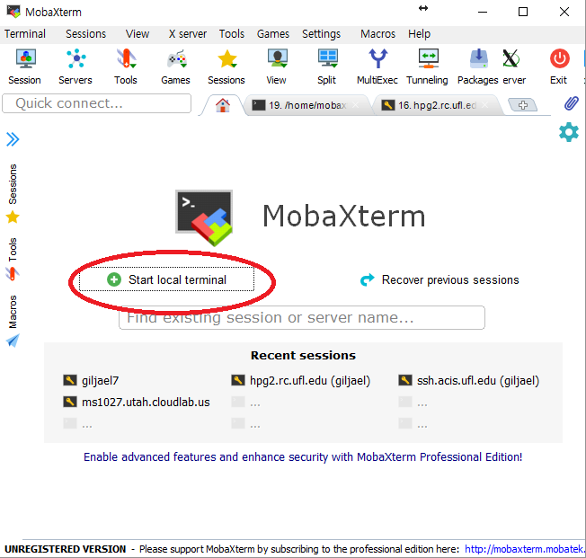
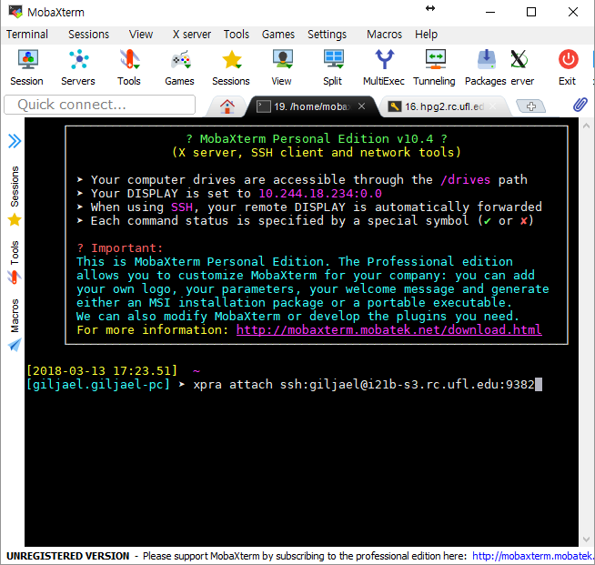
DIY2: Spark Web Monitoring through Xpra
Connect your GUI client to HiPerGator through the GUI session open
Copy the command line to your local terminal

Slide 23
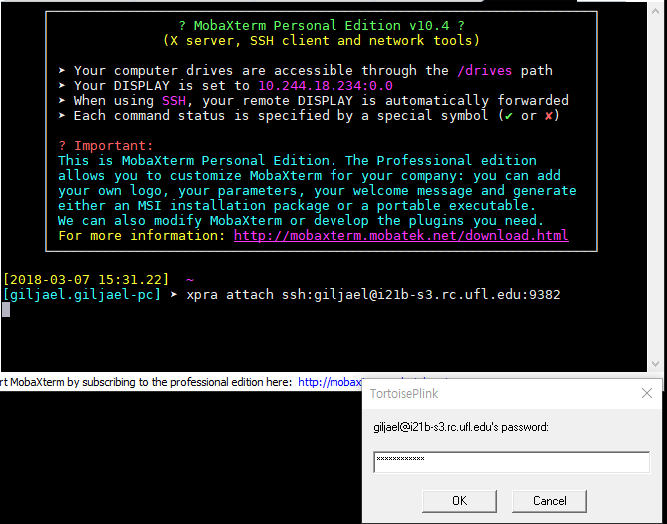
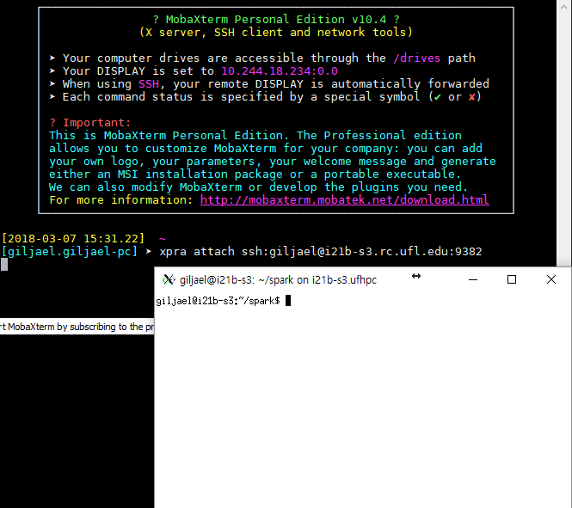
DIY2: Spark Web Monitoring through Xpra
Enter your credential to access the GUI session

Slide 24
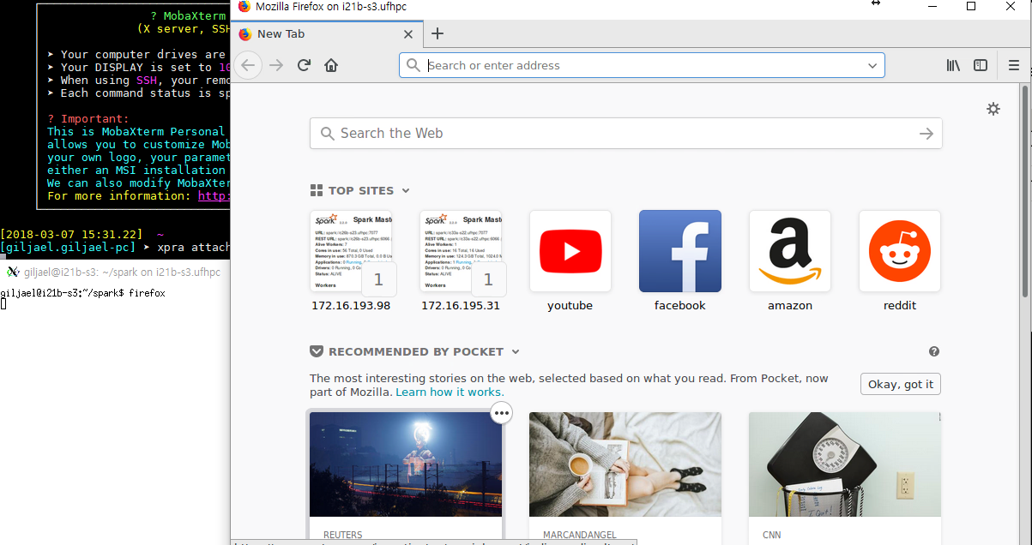
DIY2: Spark Web Monitoring through Xpra
Get the IP address for the web interface of the master node and launch firefox in the X-terminal
$> grep MasterWebUI spark_cluster.err 18/03/07 15:12:12 INFO MasterWebUI: Bound MasterWebUI to 0.0.0.0, and started at http://172.16.195.115:8080

Slide 25
DIY2: Spark Web Monitoring through Xpra

Slide 26
Break!!!

Slide 27
Spark interactive shells
Spark interactive shell in Scalar
$> spark-shell --master $SPARK_MASTER
$> SPARK_MASTER=$(grep "Starting Spark master" *.err | cut -d " " -f 9) $> spark-shell --master $SPARK_MASTER <<omitted>> Spark session available as 'spark'. Welcome to ____ __ / __/__ ___ _____/ /__ _\ \/ _ \/ _ `/ __/ '_/ /___/ .__/\_,_/_/ /_/\_\ version 2.2.0 /_/ Using Scala version 2.11.8 (Java HotSpot(TM) 64-Bit Server VM, Java 1.8.0_31) Type in expressions to have them evaluated. Type :help for more information. scala>

Slide 28
Spark interactive shells
Spark interactive shell in Scalar
$> spark-shell --master $SPARK_MASTER
$> SPARK_MASTER=$(grep "Starting Spark master" *.err | cut -d " " -f 9) $> module load spark $> spark-shell --master $SPARK_MASTER <<omitted>> Spark session available as 'spark'. Welcome to ____ __ / __/__ ___ _____/ /__ _\ \/ _ \/ _ `/ __/ '_/ /___/ .__/\_,_/_/ /_/\_\ version 2.2.0 /_/ Using Scala version 2.11.8 (Java HotSpot(TM) 64-Bit Server VM, Java 1.8.0_31) Type in expressions to have them evaluated. Type :help for more information. scala>

Slide 29
Spark interactive shells
Spark interactive shell in Python
$> pyspark --master $SPARK_MASTER
$> SPARK_MASTER=$(grep "Starting Spark master" *.err | cut -d " " -f 9) $> pyspark --master $SPARK_MASTER <<omitted>> Welcome to ____ __ / __/__ ___ _____/ /__ _\ \/ _ \/ _ `/ __/ '_/ /__ / .__/\_,_/_/ /_/\_\ version 2.2.0 /_/ Using Python version 2.7.6 (default, Feb 5 2014 11:52:59) SparkSession available as 'spark'. >>>

Slide 30
DIY3: Pi estimation via interactive shell in python
Estimate Pi (π) by "throwing darts" at a circle. Points in the unit square ((0, 0) to (1,1)) are randomly picked and observed how many fall in the unit circle. The fraction should be π / 4, so this is used to get the estimation.
from operator import add from random import random partitions = 10 # any value n = 100000 * partitions def f(_): x = random() * 2 - 1 y = random() * 2 - 1 return 1 if x ** 2 + y ** 2 <= 1 else 0 count = sc.parallelize(range(1, n + 1), partitions).map(f).reduce(add) print("Pi is roughly %f" % (4.0 * count / n))

Slide 31
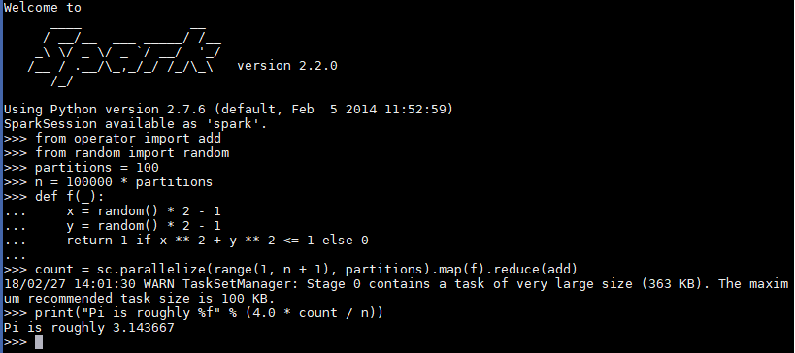
DIY3: Pi estimation via interactive shell in python
Start Spark interactive shell in Python (pyspark)
$> SPARK_MASTER=$(grep "Starting Spark master" *.err | cut -d " " -f 9) $> pyspark --master $SPARK_MASTER

Slide 32
DIY4: Pi estimation from file with pyspark
Running python application through pyspark is not supported as of Spark 2.0. That is, Spark interactive shell in python does not load python files to run python application.
Instead, “PYTHONSTARTUP”, a python environmental variable can be used to run python script with pyspark, which executes the python script before an interactive shell starts.
$> PYTHONSTARTUP=diy4.py pyspark --master $SPARK_MASTER

Slide 33
DIY4: Pi estimation from file with pyspark
$> cp /ufrc/spark_workshop/shared/diy4.py . $> cat diy4.py from operator import add from random import random partitions =10 n = 100000 * partitions def f(_): x = random() * 2 - 1 y = random() * 2 - 1 return 1 if x ** 2 + y ** 2 <= 1 else 0 count = sc.parallelize(range(1, n + 1), partitions).map(f).reduce(add) print("Pi is roughly %f" % (4.0 * count / n))

Slide 34
DIY4: Pi estimation from file with pyspark
$> SPARK_MASTER=$(grep "Starting Spark master" *.err | cut -d " " -f 9) $> PYTHONSTARTUP=diy4.py pyspark --master $SPARK_MASTER Picked up _JAVA_OPTIONS: Python 2.7.6 … <<omitted>> Welcome to ____ __ / __/__ ___ _____/ /__ _\ \/ _ \/ _ `/ __/ '_/ /__ / .__/\_,_/_/ /_/\_\ version 2.2.0 /_/ Using Python version 2.7.6 (default, Feb 5 2014 11:52:59) SparkSession available as 'spark'. 18/03/07 16:32:59 WARN TaskSetManager: Stage 0 contains a task of very large size (363 KB). The maximum recommended task size is 100 KB. Pi is roughly 3.143180 >>>

Slide 35
spark-submit
A script which provides unified interface for Spark jobs
--class: The entry point for your application (e.g. org.apache.spark.examples.SparkPi)
--master: The master URL for the cluster (e.g. spark://123.45.67.890:7077)
--deploy-mode: Whether to deploy your driver on the worker nodes (cluster) or locally as an external client (client) (default: client)
--conf: Arbitrary Spark configuration property in key=value format. For values that contain spaces wrap “key=value” in quotes (as shown).
<application-jar>: Path to a bundled jar including your application and all dependencies. The URL must be globally visible inside of your cluster, for instance, an hdfs:// path or a file:// path that is present on all nodes.
<application-arguments>: Arguments passed to the main method of your main class, if any
For further details about spark-submit, refer to https://spark.apache.org/docs/2.2.0/submitting-applications.html.
./bin/spark-submit \ --class <main-class> --master <master-url> \ --deploy-mode <deploy-mode> --conf <key>=<value> \ ... # other options <application-jar> [application-arguments]
Notes:
To launch applications in Python, simply pass not a JAR but <application>.py in the place of <application-jar> and add Python .zip, .egg or .py files to the search path with --py-files

Slide 36
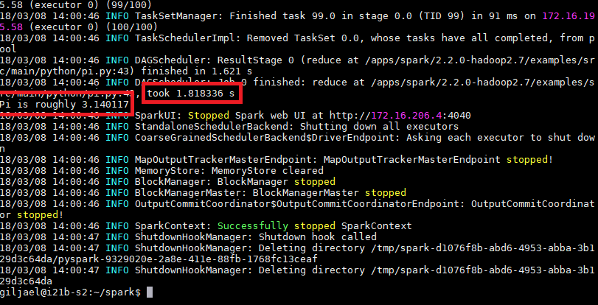
DIY5: Pi estimation using spark-submit
$> SPARK_MASTER=$(grep "Starting Spark master" *.err | cut -d " " -f 9) $> spark-submit --master $SPARK_MASTER $SPARK_HOME/examples/src/main/python/pi.py 10

Slide 37
DIY6: Wordcount using spark-submit
$> SPARK_MASTER=$(grep "Starting Spark master" *.err | cut -d " " -f 9) $> spark-submit --master $SPARK_MASTER $SPARK_HOME/examples/src/main/python/wordcount.py spark_cluster.err > wc.result $> cat wc.result : 36 command:: 6 Master:: 48 app-20180308135820-0000: 5 "-Dspark.driver.port=43217": 1 Unable: 2 kill: 5 ALIVE: 1 ExecutorRunner:: 16 /apps/spark/2.2.0-hadoop2.7: 1 giljael: 16 172.16.206.4:51098: 1 bootstraps): 1 …
Login to HiperGator

Slide 38
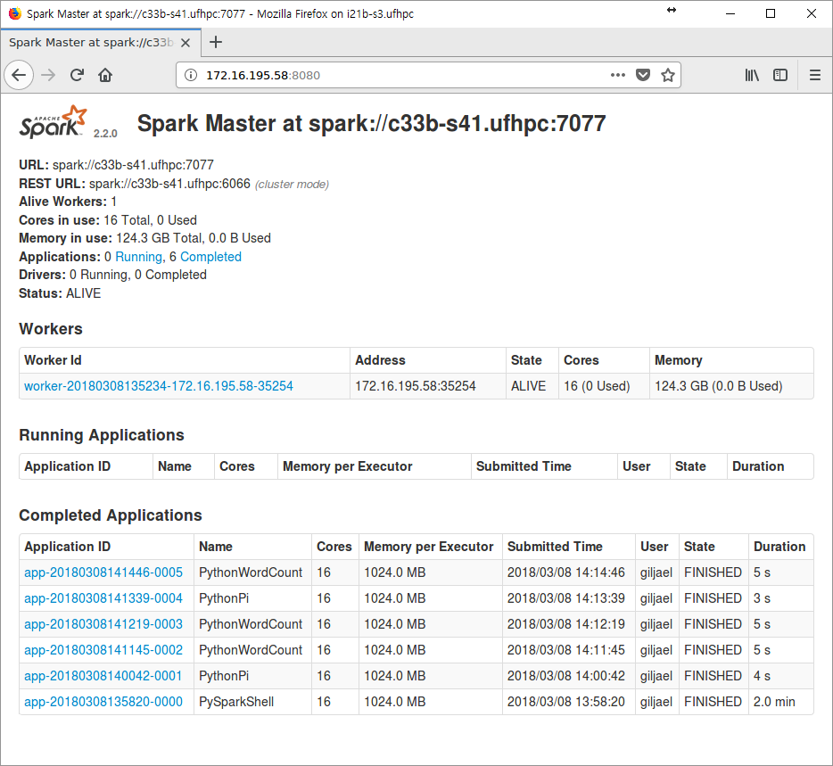
Spark job history

Slide 39
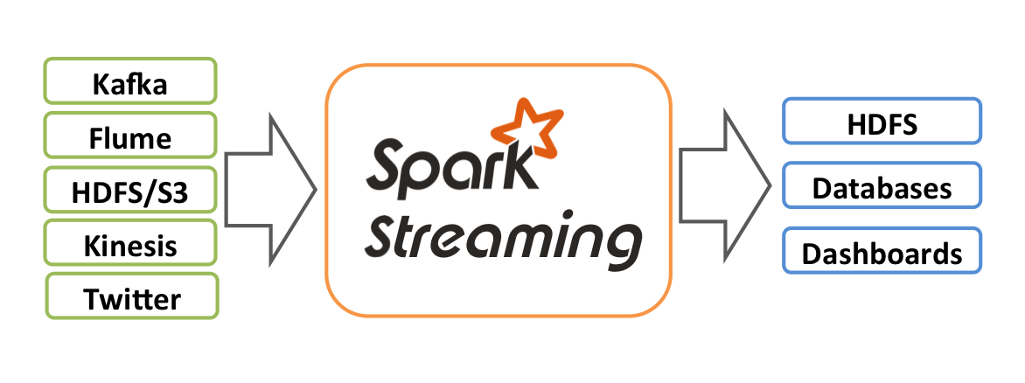
Spark streaming
An extension of the core Spark API that enables scalable, high-throughput, fault-tolerant stream processing of live data streams
Spark streaming process

Slide 40
DIY7: Wordcount using Spark streaming
Step 1: Run a network server using netcat
Step 2: Run the streaming version of the Spark wordcount (network_wordcount.py)
Step 3: Send words to the Spark wordcount example through the network server

Slide 41
DIY7: Wordcount using Spark streaming
Step 1: Run a network server using netcat
Load module ufrc for netcat executable
Get an arbitrary port to use for netcat server
Start the netcat server with the port acquired
$> module load ufrc $> which nc /apps/ufrc/bin/nc
$> port=$(shrf –u 20000-30000 –n 1) $> echo $port
$> nc –v –l –p $port listening on [any] 22496

Slide 42
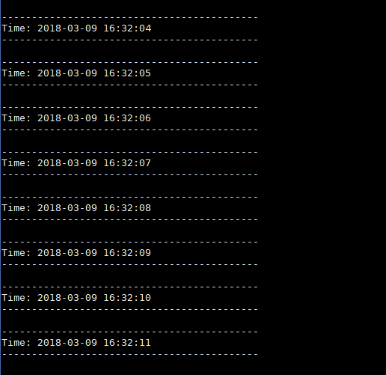
DIY7: Wordcount using Spark streaming
Step 2: Run the streaming version of the Spark wordcount (network_wordcount.py)
$> SPARK_MASTER=$(grep "Starting Spark master" *.err | cut -d " " -f 9) $> spark-submit --master $SPARK_MASTER $SPARK_HOME/examples/src/main/python/streaming/network_wordcount.py <host name nc is running> <port> 2> /dev/null

Slide 43
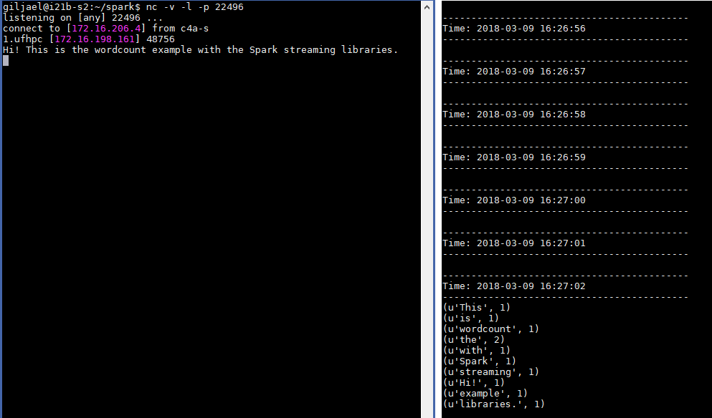
DIY7: Wordcount using Spark streaming
Step 3: Send words to the Spark wordcount example through the network server

Slide 44
Advanced topics
Deep learning with TensorFlow on Apache Spark
https://databricks.com/blog/2016/01/25/deep-learning-with-apache-spark-and-tensorflow.html
Genome analysis with ADAM and Apache Spark
https://github.com/bigdatagenomics/adam
GPU acceleration on Apache Spark
http://www.spark.tc/gpu-acceleration-on-apache-spark-2/
RDMA (remote direct memory access)-based Apache Spark
http://hibd.cse.ohio-state.edu/#spark
Etc.

