Slide 1
Galaxy For Users
Oleksandr Moskalenko, Ph.D.
University of Florida Research Computing
Super Computing 2012, Salt Lake City, Nov 12-15, 2012

Slide 2
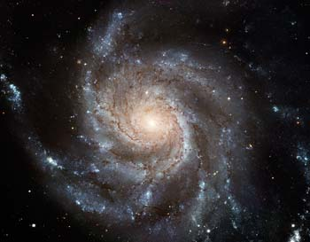
What is Galaxy?

Slide 3
Computational biology platform
Open
Web-based
Accessible
Reproducible
Transparent
Flexible
Secure
Collaborative

Slide 4
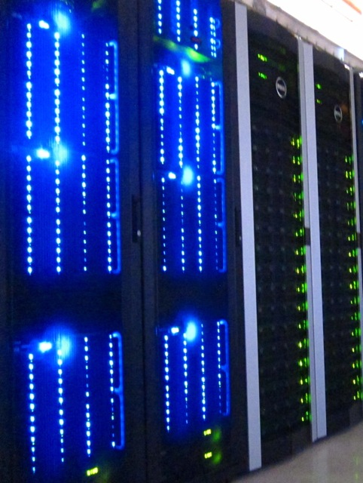
Batch Environment
Head node
Scheduler
Computing
resources
Interactive session or batch submission
Login to head node
Your job runs on the cluster

Slide 5
Galaxy Analysis Workspace

Slide 6
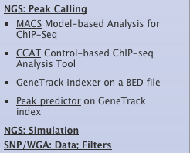
Tool panel

Slide 7
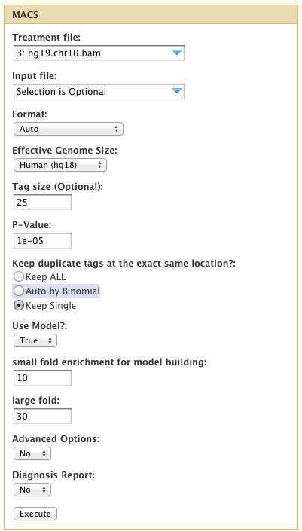
Tool Interface

Slide 8
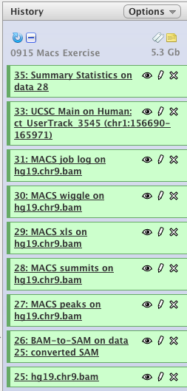
History Panel

Slide 9
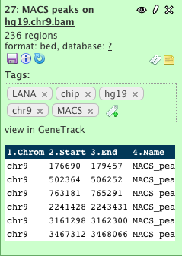
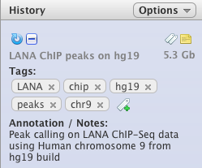
Metadata

Slide 10
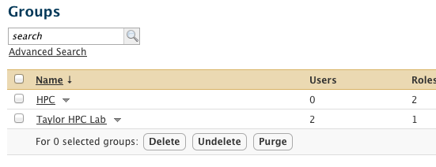
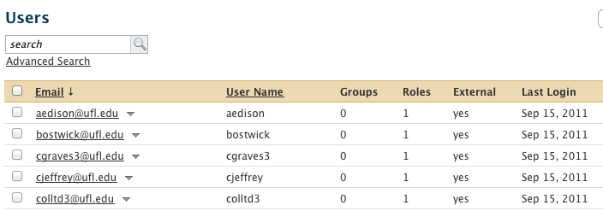
Data Access and Sharing

Slide 11
Data Inflow
UCSC table browser
Biomart
interMine / modMine
EuPathDB
EncodeDB
EpiGRAPH
FlyMine
GrameneMart…
SCP
FTP
Web upload

Slide 12
Data Outflow
UCSC table browser
Download
Publish via “Pages”
Share within Galaxy
Import/Export between instances
Export to other tools

Slide 13
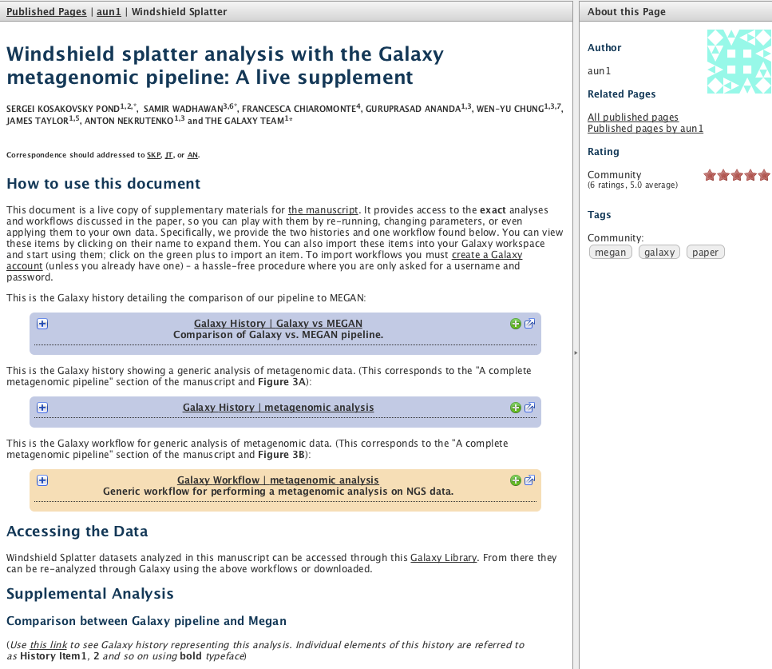
Data Sharing

Slide 14
Automation via workflows

Slide 15
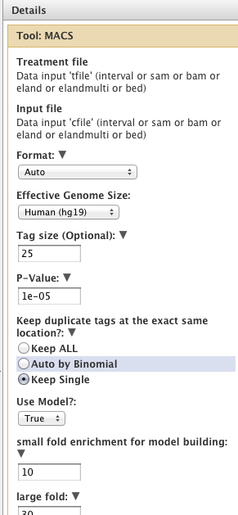
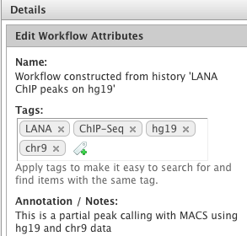
Workflow editing

Slide 16
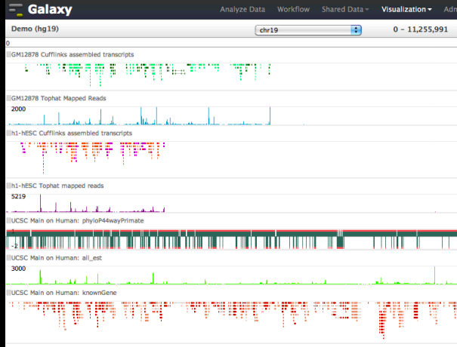
Visual Interactive Analysis
Trackster

Slide 17
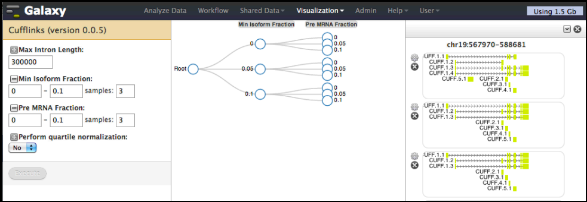
Visual Interactive Analysis
Sweepster

Slide 18
Administrative side
User, data library, job administration, management and reporting
Integration of new tools via wrappers
Modular and scalable (database, web server, web and job runners)
API for command-line access
ToolShed model for CLI tools, ENV

Slide 19
Batch System Integration
All major schedulers
Condor; XSEDE
drmaa and pbs_python libraries
Fixed and dynamic job runners
Free-for-all and real user jobs
Infinite scaling

Slide 20
Community
Large and growing community
Mailing lists
Revision control system
Issue tracking
IRC
Community Conference

Slide 21
Summary
Web-based computational framework
Future of research computing
Built for researchers
Flexible and highly functional

Slide 22
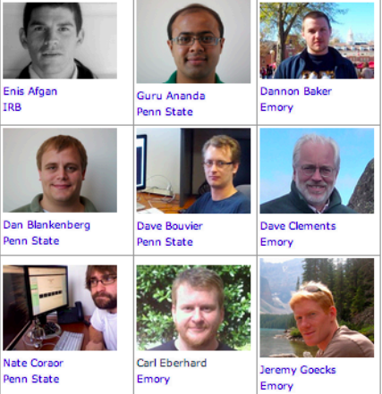
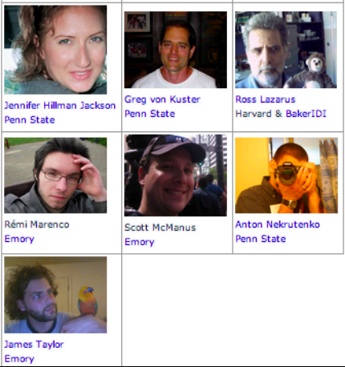
Galaxy Team
Community

